Slide 1
Data Analysis of Sound Objects Positioning to Help Web designers to Enhance Web Functionality
Presented By
BIBEK LAMSAL

Slide 2
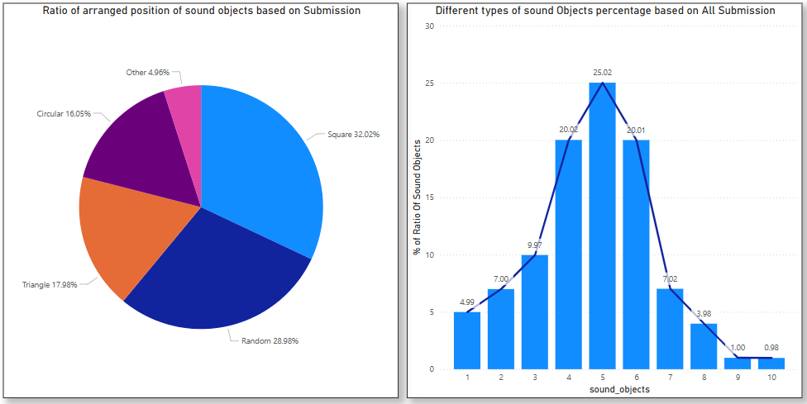
Visualization using dashboard

Slide 3
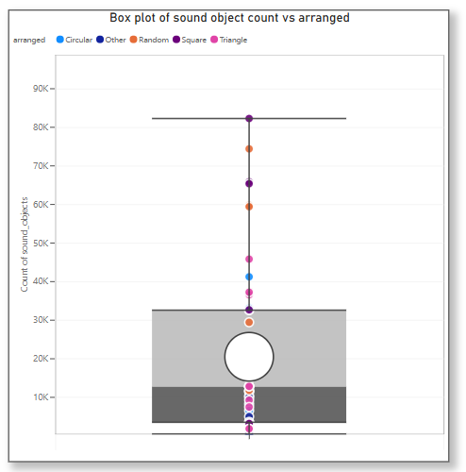

Slide 4
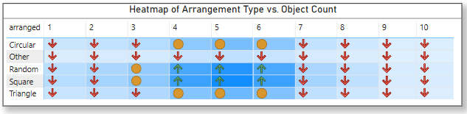
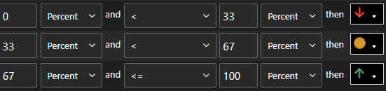

Slide 5
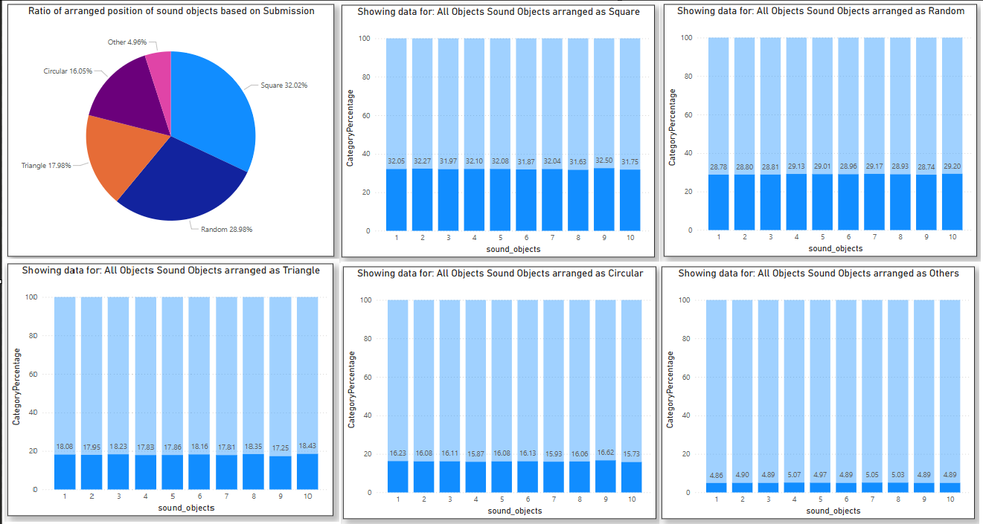

Slide 7
Insight:
Square Arrangement is Most Preferred: Square arrangements dominate with 32% of total submissions, followed by Random (29%), Triangle (18%), and Circular (16%). Heatmap tells us that 4,5,6 are the common sound object on these above arrangement.
Most Common Sound Object is 5: The bar chart shows 25.02% of all submissions used exactly 5 sound objects, the highest percentage, forming a clear peak.
Balanced Use of 4 and 6 Sound Objects: 4 (20.02%) and 6 (20.01%) sound objects are also commonly used, forming a symmetric bell-curve pattern with 5 as the center.
Consistency in Arrangement Distribution Across Counts: The distribution of arrangement types (Square, Random, Triangle, Circular) remains consistent across all sound object counts from 1 to 10+, indicating users don’t change layout preference based on number.
Complex Arrangements Are Less Preferred for Circular and Other Types: Circular (16.09%) and Other (4.94%) arrangements are much less frequent. The usage of Circular shapes declines further as sound object count increases which is suggesting designers may prefer simpler or more predictable layouts when working with more sound elements.

Slide 8
Recommandation
Optimize Interface for 5 Sound Objects Using Square Layout: Use Default settings as Square arrangement with 5 objects for quicker user adoption and satisfaction.
Highlight Customization Options Around Random and Triangle: They are significant but secondary, promote their creative flexibility to attract users who seek uniqueness.
Enhance Circular Layout UX for Higher Sound Counts : Simplify or redesign circular arrangements for better scalability as object count increases or introduce smart guides to ease layout complexity.

Slide 9
Call Through Action
Let’s set a meeting with the web designing team to brainstorm and test new approaches for simplify layouts design inspired by square arrangements.

